Slide 1
LEVEL 2 | MODULE 3 | ORGANIZATIONAL LEADERSHIP
Problem-Solving
Techniques &
Risk Management
Root Cause Analysis • Risk Assessment • Risk Mitigation
Cecabul Africa Leadership Accelerator
Designed for C-Suite & Senior Leaders
Cecabul Africa | Level 2: Organizational Leadership | Module 3: Problem-Solving & Risk Management

Slide 2
Module Roadmap
A C-suite journey from problem diagnosis to strategic risk command
01
The Problem-Solving Mindset
05
Risk Rating Matrix
Why leaders must diagnose before deciding
Likelihood x Impact: prioritising what matters
02
Iceberg Model
06
Risk Mitigation Strategies
Surface symptoms vs. systemic root causes
Avoid, Reduce, Transfer, Accept
03
Ishikawa (Fishbone) Diagram
07
Case Studies
Mapping causality across 6 dimensions
Global & African boardroom crises examined
04
Premortem Analysis
08
C-Suite Assignment
Imagining failure before it happens
Strategic risk audit of your organisation
Cecabul Africa | Level 2: Organizational Leadership | Module 3: Problem-Solving & Risk Management

Slide 3
01
The Problem-Solving Mindset for C-Suite Leaders
"A problem well-defined is a problem half-solved."
The Executive Problem-Solving Framework
1
DEFINE
— Charles Kettering, Engineer & Inventor
What exactly is the problem? Who owns it? What is the cost of inaction?
The C-Suite Problem-Solving Trap
2
DIAGNOSE
Solving symptoms, not root causes
What are the root causes? Use Iceberg Model and Ishikawa to go deep.
Deciding before diagnosing
3
ASSESS RISK
Confusing urgency with importance
What are the failure scenarios? Rate likelihood and impact rigorously.
Pattern-matching to past problems
4
DECIDE & MITIGATE
Excluding frontline intelligence
Choose a solution. Build mitigation into the execution plan from day one.
Cecabul Africa | Level 2: Organizational Leadership | Module 3: Problem-Solving & Risk Management

Slide 4
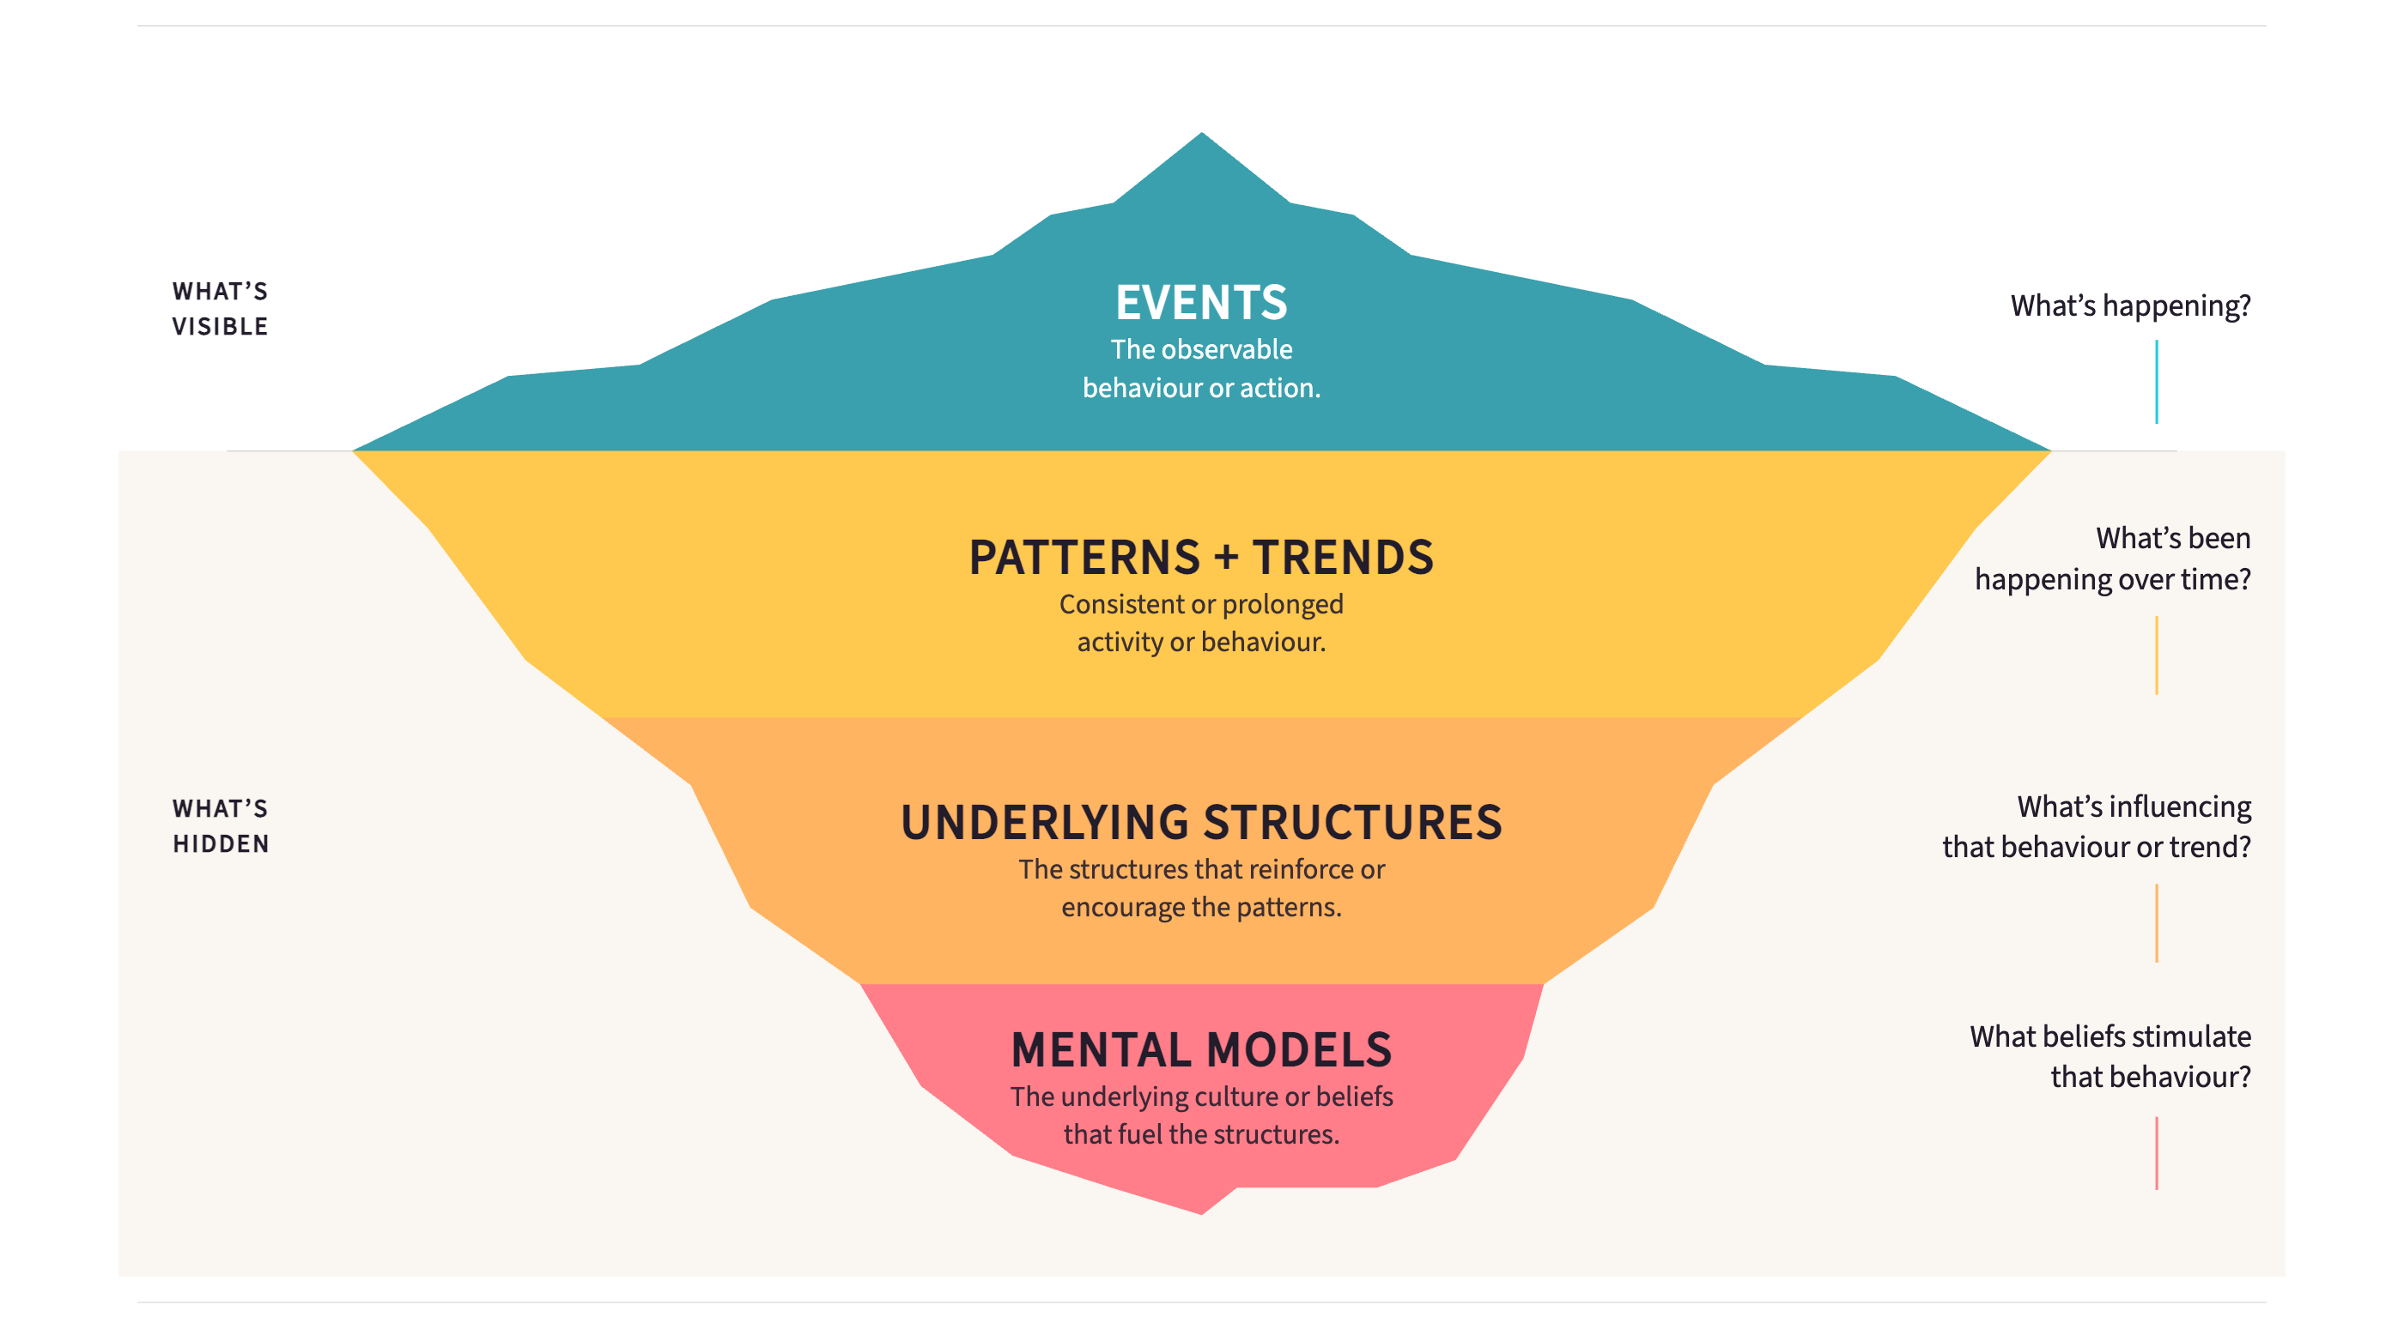
02
Root Cause Analysis: The Iceberg Model

Slide 5
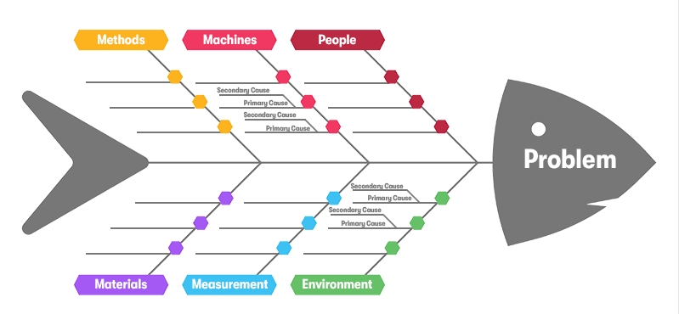
03
Ishikawa (Fishbone) Diagram — Mapping Root Causes

Slide 6
04
Premortem Analysis — Outsmarting Failure Before It Happens
What is it? Developed by psychologist Gary Klein: BEFORE executing a plan, the team imagines it is 12 months later and the project has catastrophically failed. They then work backwards to explain WHY it failed. This surfaces hidden risks that optimism and groupthink suppress.
THE 5-STEP PREMORTEM PROTOCOL
1
2
3
4
5
Set the Scene
Silent Writing
Round-Robin Sharing
Cluster & Prioritise
Redesign the Plan
"It is 12 months from now. The strategy has failed completely. This is not a success story."
Each team member independently writes every reason the failure could have occurred (5 minutes, no discussion).
Each person shares ONE reason per round. No debate. Facilitator captures all reasons on the board.
Group failure reasons by theme. Vote on which are most likely AND most catastrophic.
For the top 3-5 risks identified, revise the plan. Add safeguards, contingencies, and early-warning signals.
Why leaders avoid premortem: Optimism bias + fear of appearing negative. Why you must do it: research shows premortem increases identification of future problems by 30%.
Cecabul Africa | Level 2: Organizational Leadership | Module 3: Problem-Solving & Risk Management

